Slide 1
Software Development Lifecycle

Slide 2
Software engineering
The term Software Engineering was proposed in 1968 at a conference organized by NATO to discuss software crisis.
The economies of ALL developed nations are dependent on software.
More and more systems are software controlled.
Software engineering is concerned with theories, methods and tools for professional software development.
Expenditure on software represents a significant fraction of GNP in all developed countries.

Slide 3
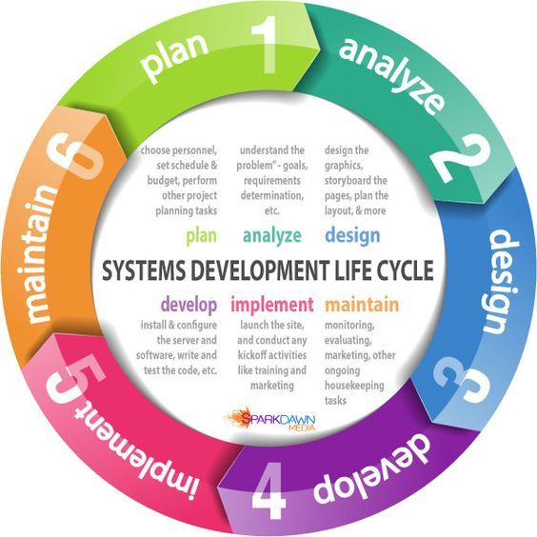
Software development lifecycle

Slide 4
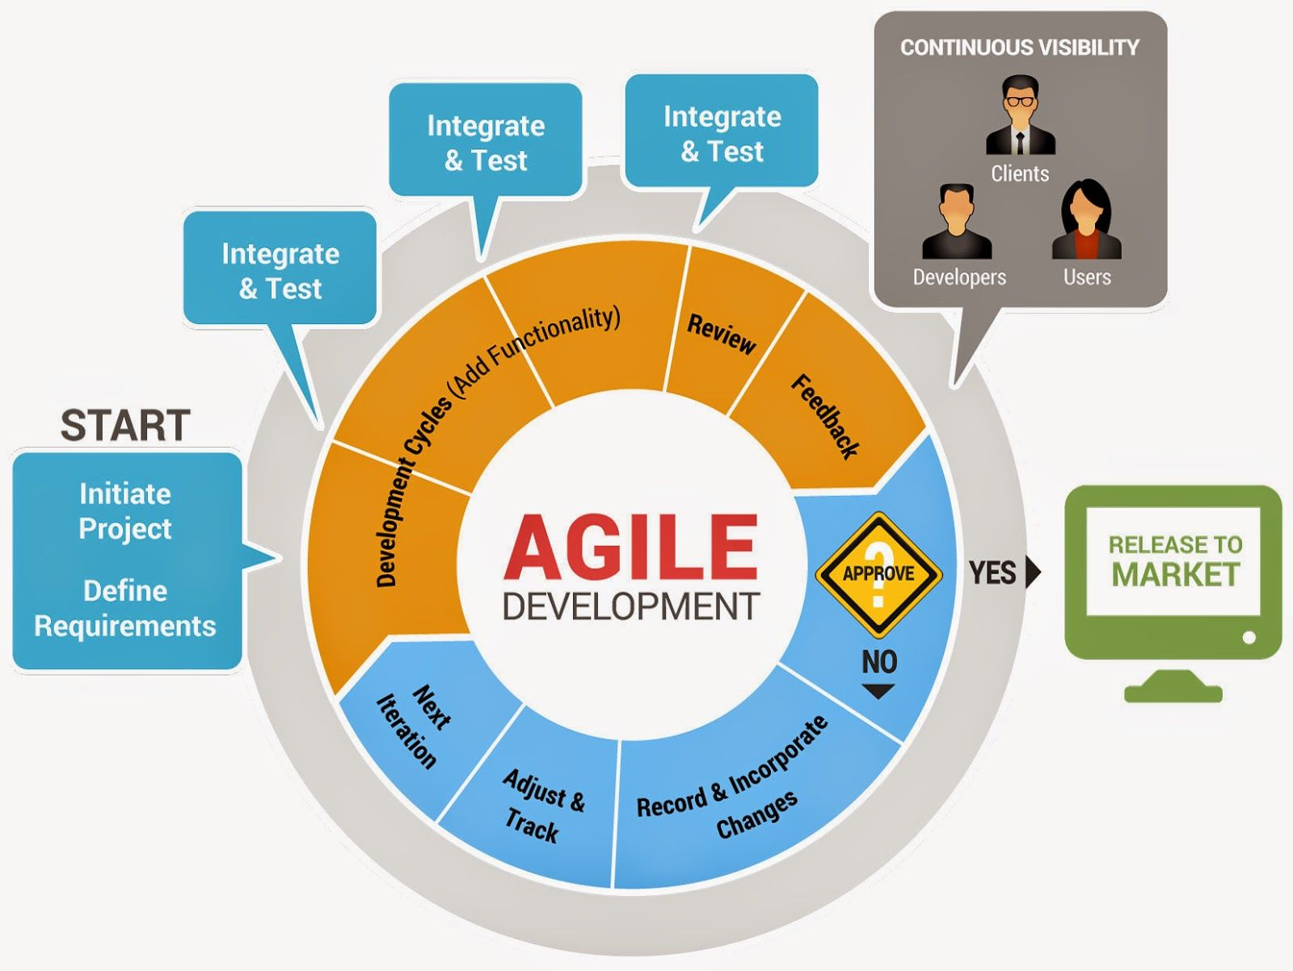
Agile development

Slide 5
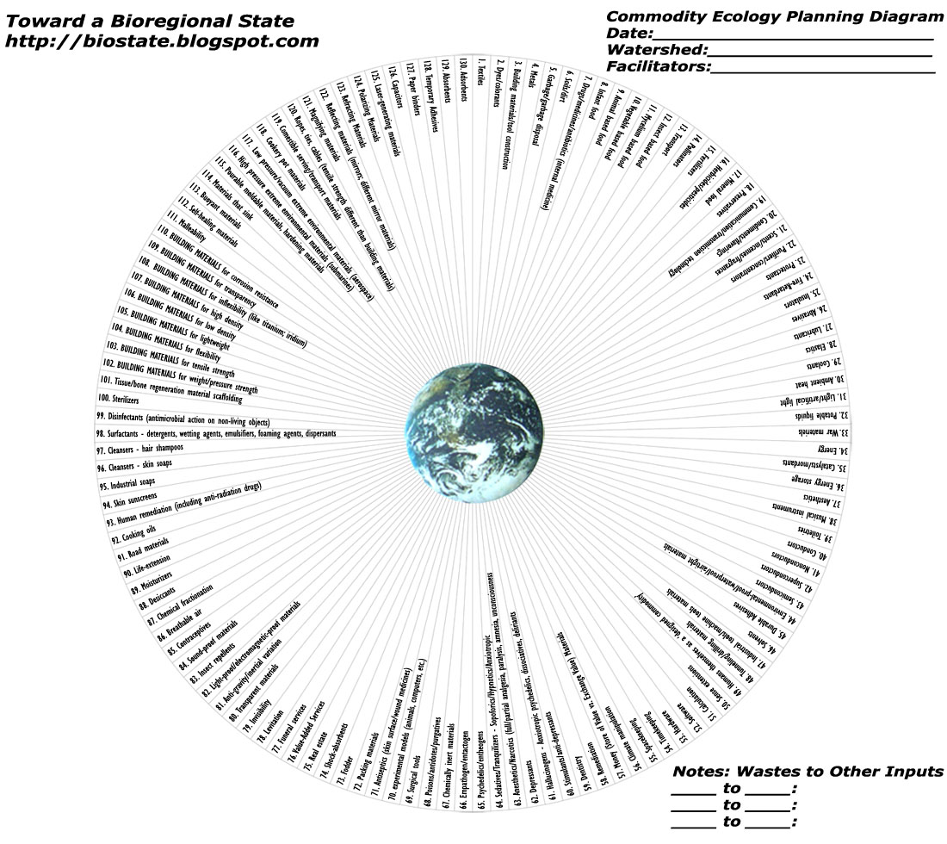
Commodity ecology

